Slide 1

Online Learning
Platform Analytics
using SQL

Slide 2


Abstract
Online Learning Platform Analytics using SQL is a database project that manages and analyzes data related to students, instructors, courses, enrollments, and payments. The project uses a relational database with primary and foreign key relationships to ensure data accuracy and consistency.
SQL queries are used to perform data retrieval, joins, filtering, aggregation, and reporting to generate meaningful business insights.

Slide 3
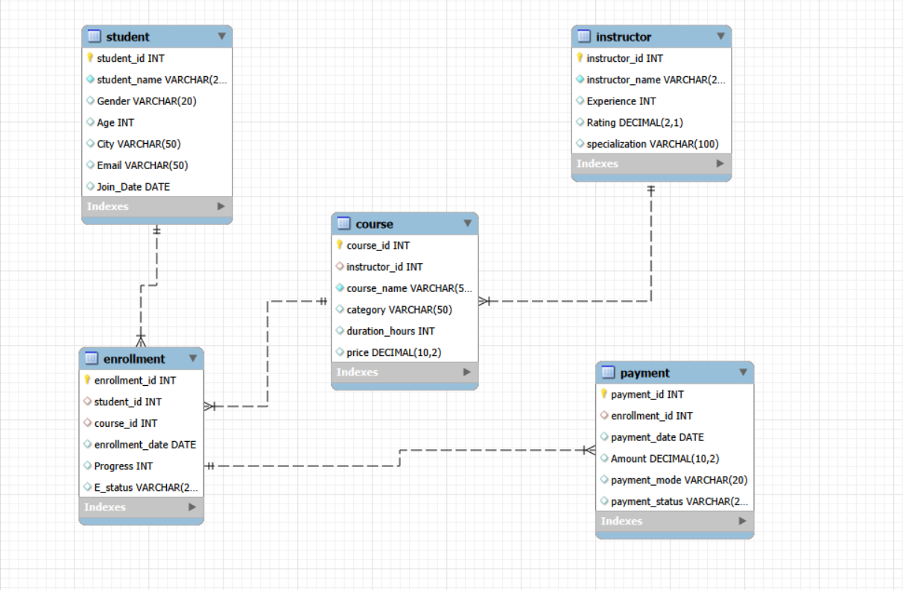
ER-DIAGRAM

Slide 4
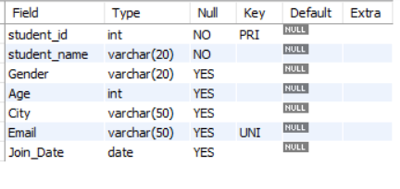

STRUCTURE OF TABLE
STUDENT
STUDENT TABLE
The Students table stores the personal and registration details of learners enrolled on the online learning platform.
Each student is assigned a unique Student_ID, which serves as the primary key to uniquely identify every record.
Syntax : DESC Student;

Slide 5
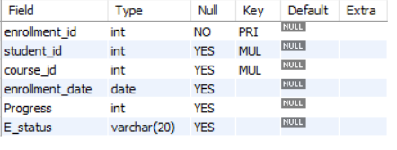

ENROLLMENT
ENROLLMENT TABLE
The Enrollments table records the courses that students have enrolled in on the online learning platform.
Record student enrollments in courses.
Track learning progress and completion status.
Connect students with their selected courses.
Syntax : DESC Enrollment ;

Slide 6
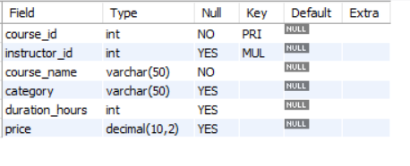

COURSE
COURSE TABLE
The Courses table stores information about all the courses offered on the online learning platform. Each course is assigned a unique Course_ID, which serves as the primary key.
Store details of all available courses.
Assign instructors to courses.
Maintain course information for enrollments and analysis.
Syntax : DESC Course ;

Slide 7
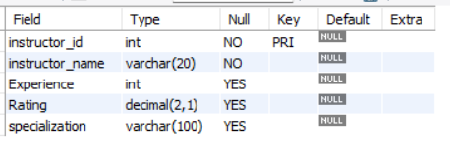

INSTRUCTOR
INSTRUCTOE TABLE
The Instructors table stores information about the instructors who teach courses on the online learning platform.
Each instructor is assigned a unique Instructor_ID, which serves as the primary key.
Syntax : DESC Instructor ;

Slide 8
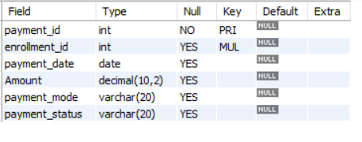

PAYMENT
PAYMENT TABLE
The Payments table stores information about the payments made by students for course enrollments on the online learning platform.
Each payment is assigned a unique Payment_ID, which serves as the primary key.
Syntax : DESC Payment ;

Slide 9
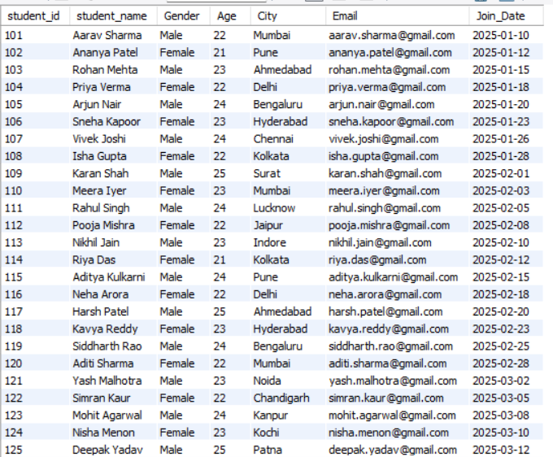
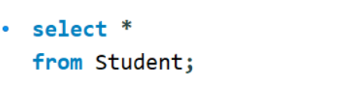
CONTENTS OF TABLE
STUDENT TABLE
Syntax :
SELECT * FROM Student ;

Slide 10
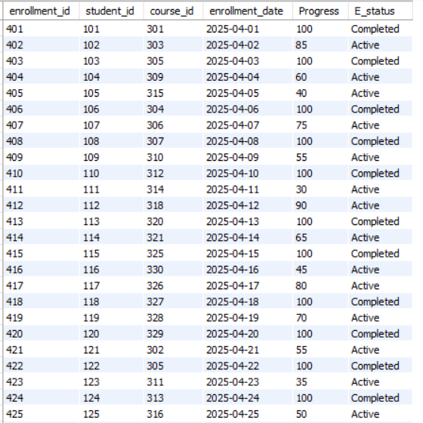
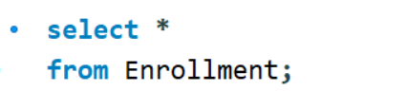
ENROLLMENT TABLE
Syntax :
SELECT * FROM Enrollment ;

Slide 11
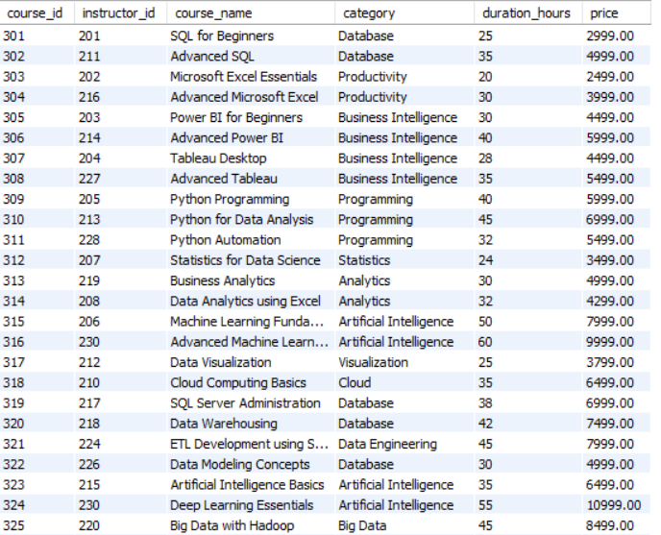

COURSE TABLE
Syntax :
SELECT * FROM Course ;

Slide 12
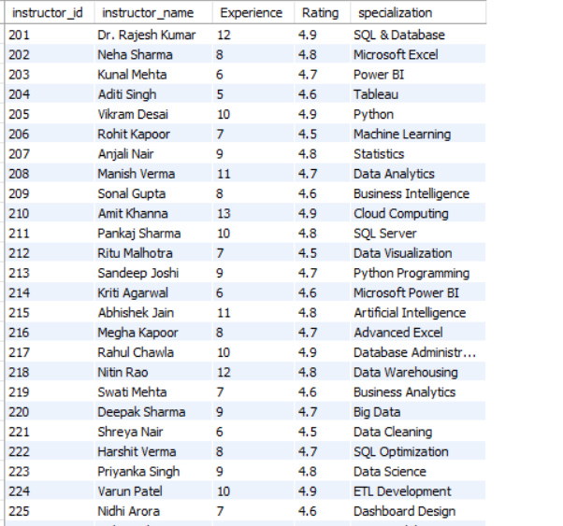

INSTRUCTOR TABLE
Syntax :
SELECT * FROM Instructor ;

Slide 13
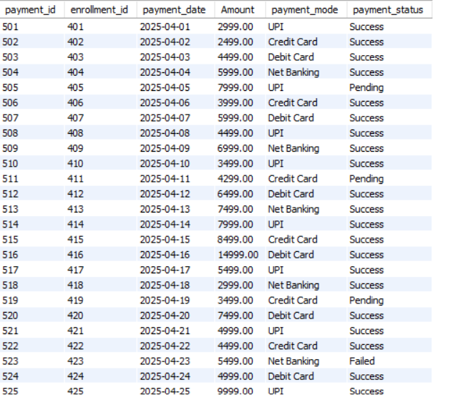

PAYMENT TABLE
Syntax :
SELECT * FROM Payment ;

Slide 14
JOINS
QUERY

Slide 15
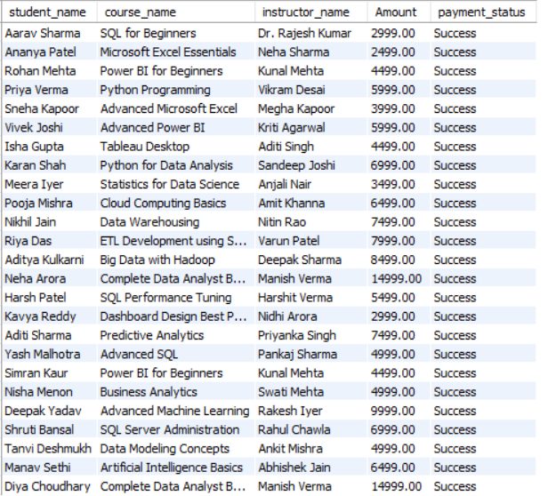
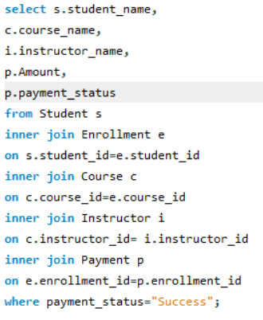
inner join
display the student name, course name , instructor name and payment amount for all sucssfull payment.
SYNTAX :
select s.student_name,
c.course_name,
i.instructor_name,
p.Amount
from Student s
inner join Enrollment e
on s.student_id=e.student_id
inner join Course c
on c.course_id=e.course_id
inner join Instructor I
on c.instructor_id= i.instructor_id
inner join Payment p
on e.enrollment_id=p.enrollment_id
where payment_status="Success";

Slide 16
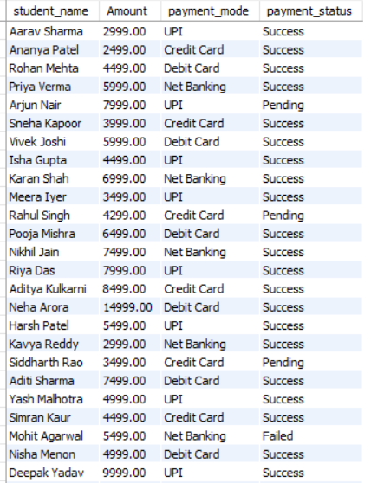
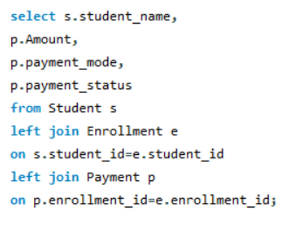
Left join
Display all students along with their payment details. Include students who have not made any payment.
SYNTAX :
select s.student_name,
p.Amount,
p.payment_mode,
p.payment_status
from Student s
left join Enrollment e
on s.student_id=e.student_id
left join Payment p
on p.enrollment_id=e.enrollment_id;

Slide 17
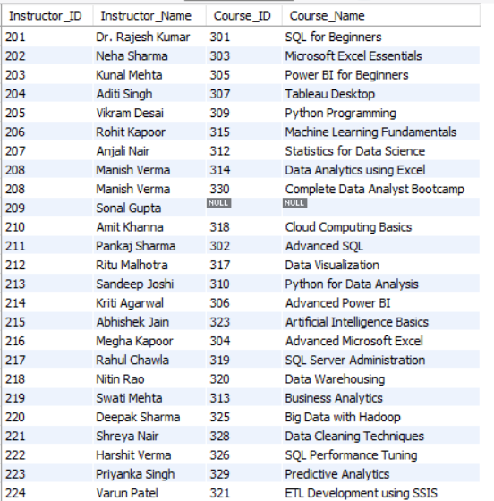
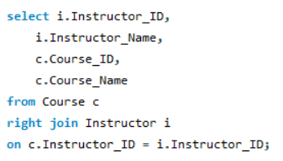
Right join
Show all instructors and the courses they teach, including instructors who are not assigned to any course.
SYNTAX :
select i.Instructor_ID, i.Instructor_Name,
c.Course_ID,
c.Course_Name
from Course c
right join Instructor I
on c.Instructor_ID = i.Instructor_ID;

Slide 18
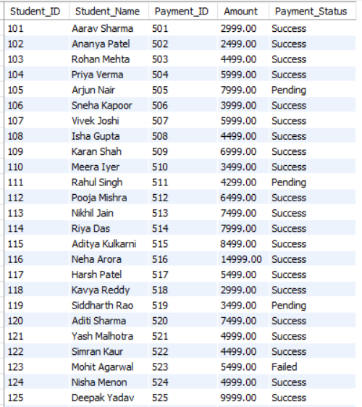
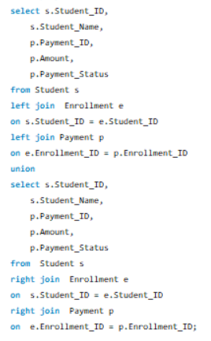
Full Outer Join
Display all students and all payment records, including students who have never made a payment and payments without matching student details.
SYNTAX :
select s.Student_ID, s.Student_Name,
p.Payment_ID, p.Amount,
p.Payment_Status
from Student s
left join Enrollment e
on s.Student_ID = e.Student_ID
left join Payment p
on e.Enrollment_ID = p.Enrollment_ID
union
select s.Student_ID, s.Student_Name,
p.Payment_ID, p.Amount,
p.Payment_Status
from Student s
right join Enrollment e
on s.Student_ID = e.Student_ID
right join Payment p
on e.Enrollment_ID = p.Enrollment_ID;

Slide 19
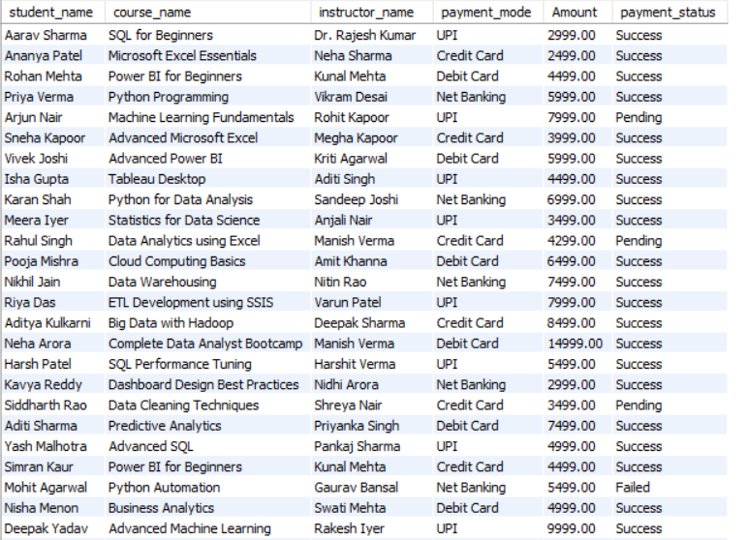
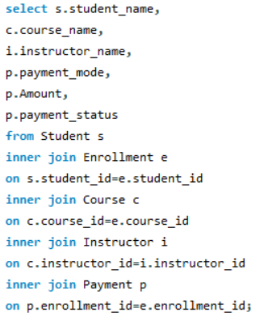
Multiple Join
Display the student name, course name, instructor name, payment mode, payment amount, and payment status.
SYNTAX :
select s.student_name ,
c.course_name ,
i.instructor_name ,
p.payment_mode ,
p.Amount,
p.payment_status
from Student sinner join Enrollment e
on s.student_id=e.student_id
inner join Course c
on c.course_id=e.course_id
inner join Instructor I
on c.instructor_id=i.instructor_idinner
join Payment p
on p.enrollment_id=e.enrollment_id;

Slide 20
SUBQUERIES

Slide 21
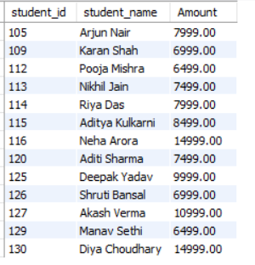
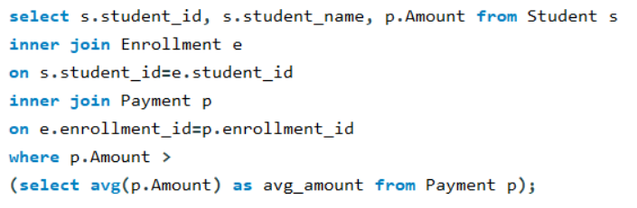
Display the Student ID, Student Name, and Payment Amount of students whose payment amount is greater than the average payment amount
SYNTAX :
select s.student_id, s.student_name, p.Amount
from Student s
inner join Enrollment e
on s.student_id=e.student_id
inner join Payment p
on e.enrollment_id=p.enrollment_id
where p.Amount >
(select avg(p.Amount) as avg_amount
from Payment p);

Slide 22

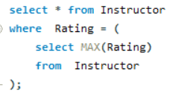
Display the instructor with the highest rating
SYNTAX :
select * from Instructor
where Rating =
(
select MAX(Rating)
from Instructor
);

Slide 23

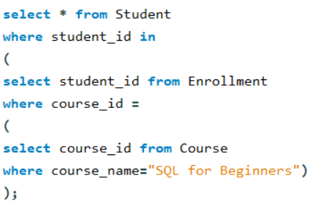
Display the names of students who are enrolled in the course "SQL for Beginners".
SYNTAX :
select * from Student
where student_id in
(
select student_id from Enrollment
where course_id =
(
select course_id from Course
where course_name="SQL for Beginners“
)
);

Slide 24

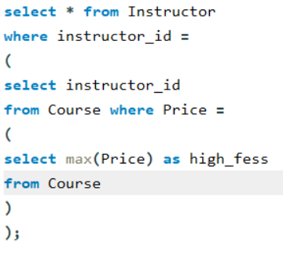
Display the Instructor Name who teaches the course with the highest fee.
SYNTAX :
select * from Instructor
where instructor_id =
(
select instructor_id from Course
where Price =
(
select max(Price) as high_fess
from Course
)
);

Slide 25
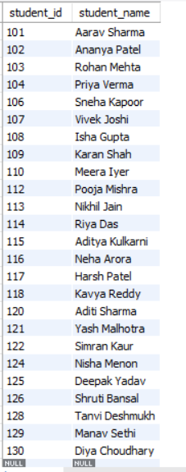
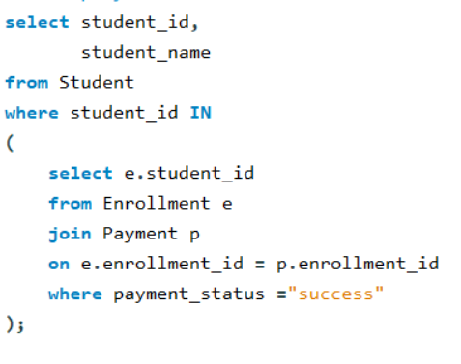
Display the Student ID and Student Name of students whose Student ID payment status is successfull in the Payments table.
SYNTAX :
select student_id,
student_name
from Student
where student_id IN
(
select e.student_id
from Enrollment e
join Payment p
on e.enrollment_id = p.enrollment_id where payment_status ="success“
);

Slide 26
VIEWS
QUERY
V

Slide 27
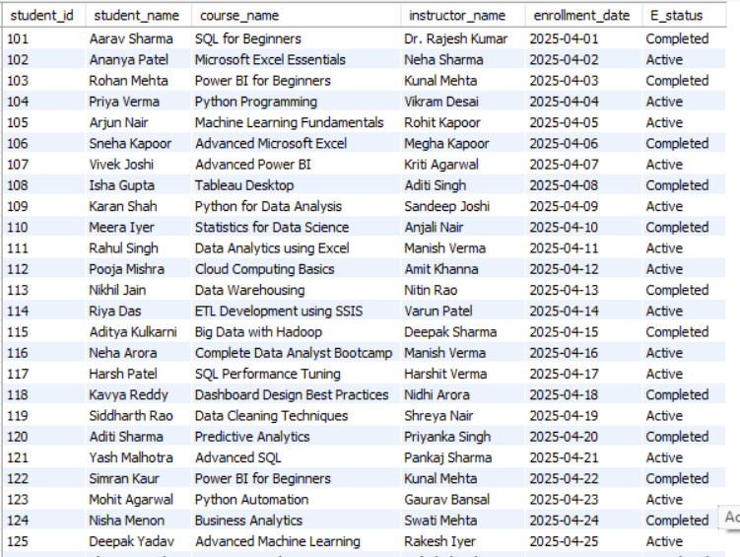
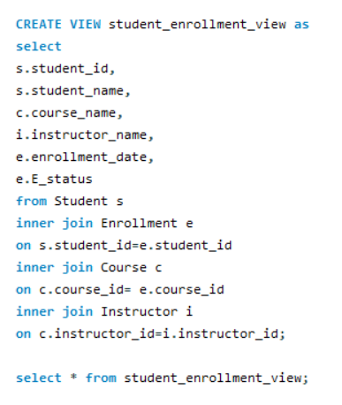
Student Enrollment View
Student ID, Student Name, Course Name, Instructor Name, Enrollment Date ,Enrollment Status
SYNTAX :
CREATE VIEW student_enrollment_view
as
select s.student_id,
s.student_name,
c.course_name,
i.instructor_name,
e.enrollment_date,
e.E_status
from Student s
inner join Enrollment e
on s.student_id=e.student_id
inner join Course c
on c.course_id= e.course_id
inner join Instructor I
on c.instructor_id=i.instructor_id;
select * from student_enrollment_view;

Slide 28
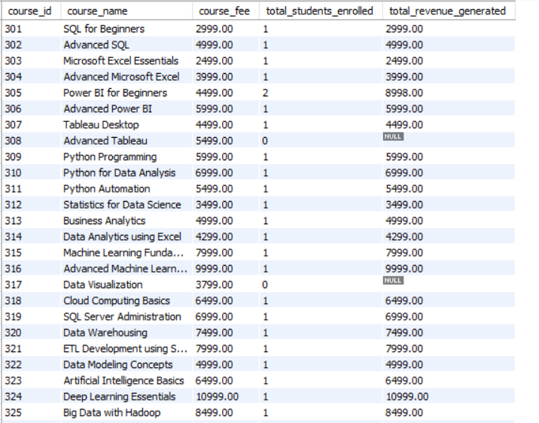
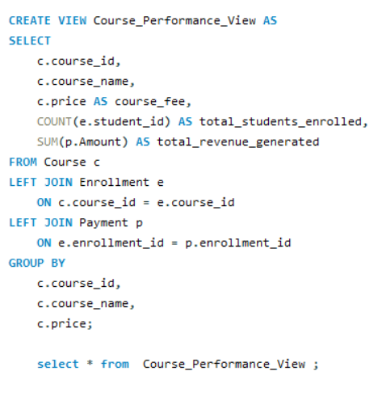
Course Performance View
Course ID, Course Name, Course Fee, Total Number of Students Enrolled, Total Revenue Generated
SYNTAX :
CREATE VIEW Course_Performance_View AS
SELECT c.course_id, c.course_name,
c.price AS course_fee, COUNT(e.student_id) AS total_students_enrolled, SUM(p.Amount) AS total_revenue_generated
FROM Course c
LEFT JOIN Enrollment e
ON c.course_id = e.course_id
LEFT JOIN Payment p
ON e.enrollment_id = p.enrollment_id
GROUP BY
c.course_id,
c.course_name,
c.price;
select * from Course_Performance_View ;

Slide 29
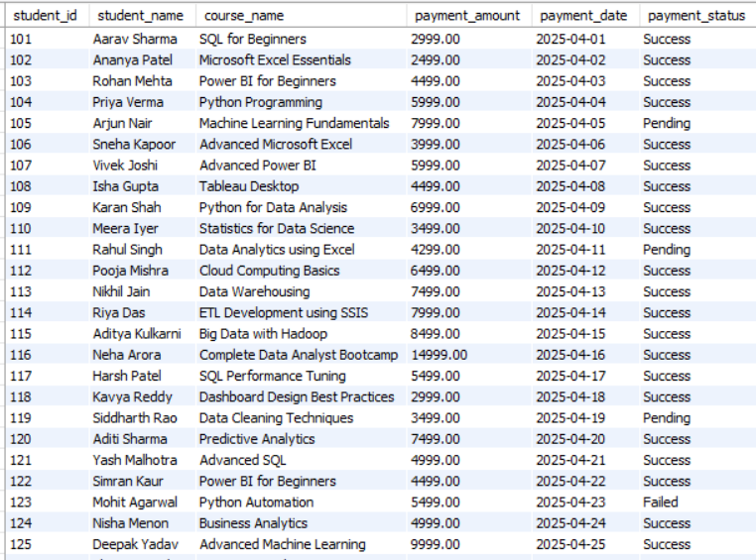
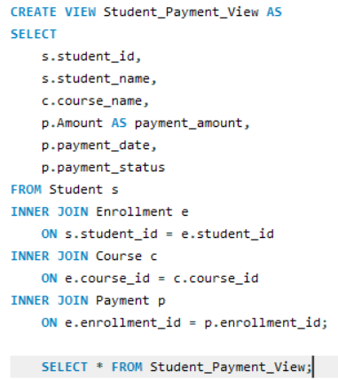
Student Payment View
Student ID, Student Name, Course Name, Payment Amount, Payment Date, Payment Status
SYNTAX :
CREATE VIEW Student_Payment_View
AS
SELECT
s.student_id,
s.student_name,
c.course_name,
p.Amount AS payment_amount, p.payment_date, p.payment_status
FROM Student s
INNER JOIN Enrollment e
ON s.student_id = e.student_id
INNER JOIN Course c
ON e.course_id = c.course_id
INNER JOIN Payment p
ON e.enrollment_id = p.enrollment_id;
SELECT * FROM Student_Payment_View;

Slide 30
THANK
YOU

